Slide 1
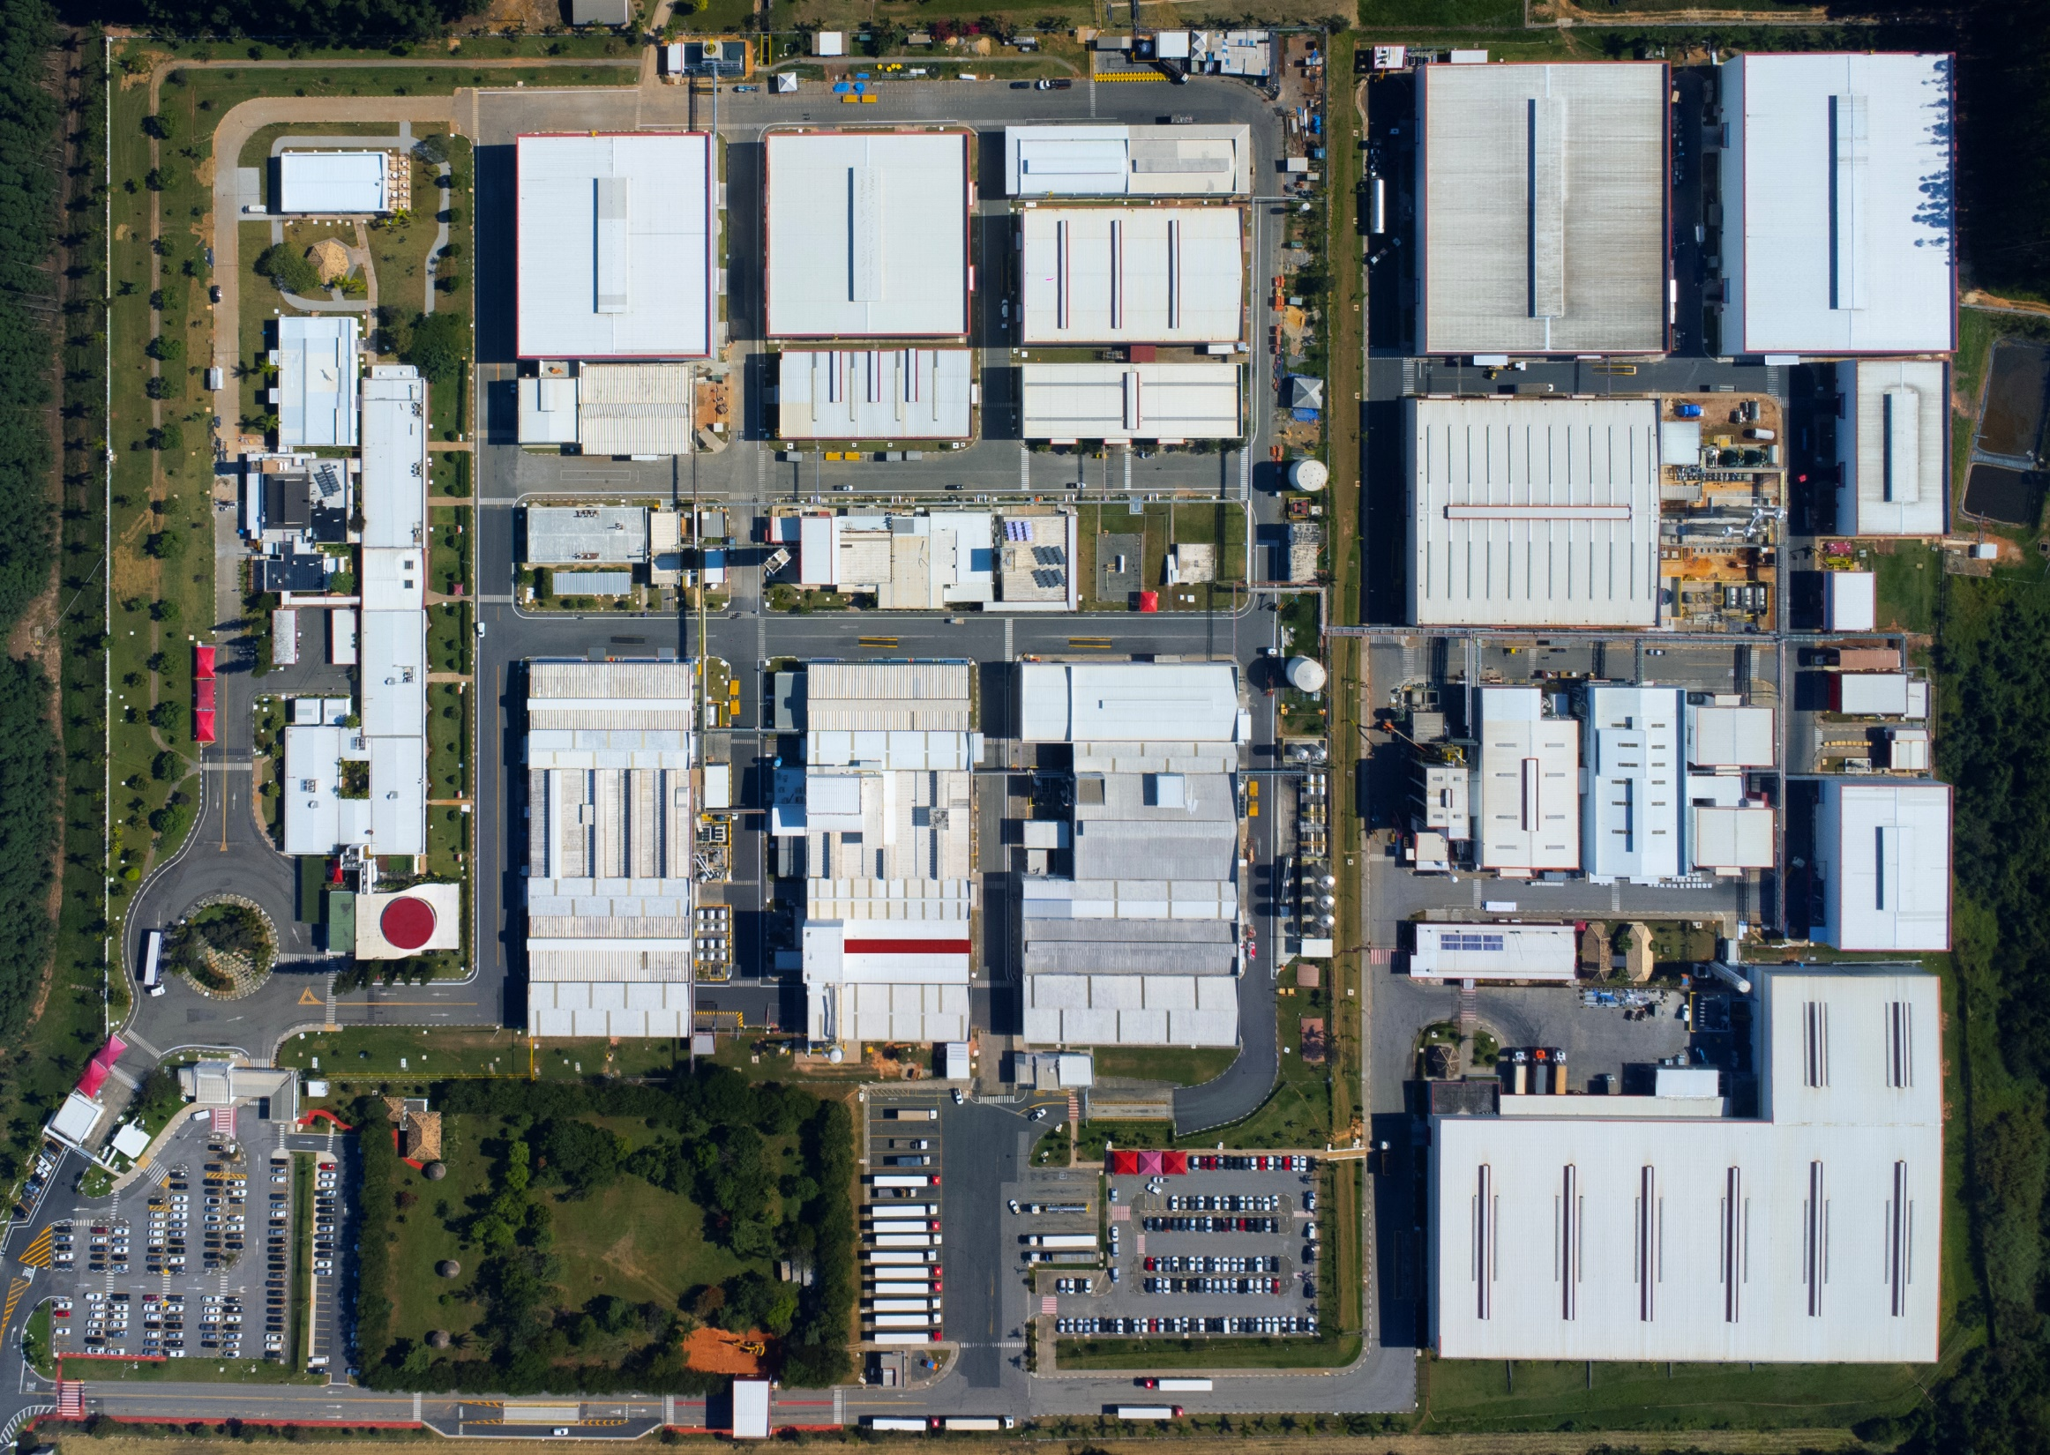




























DEPÓSITO DE
PASSIVO
PA01
FH07
FH03
FF07
E001
MP01
FH02
MP02
BPST
FH01
BFW2
FF01
FP01
FL07
FL01
BLQ1
BFLE
BLQ3
AFW0
AWPG
BSIN
ALQ0
BFW1
BLQ2
EXEN
WG01
FF02
EXFW
EXWG
EXLQ
FBPR
FB01

